Slide 1
CSE 228 – Principles of Artificial Intelligence
Module #3, Lecture #

Slide 2
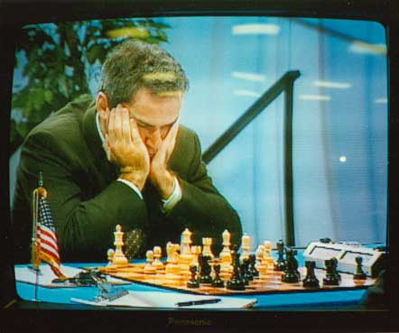
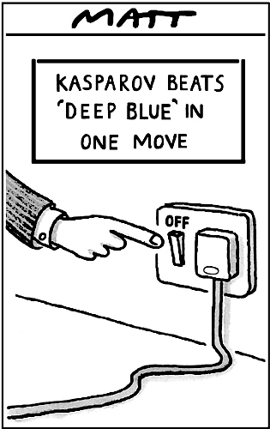
Adversarial search
World Champion chess player Garry Kasparov is defeated by IBM’s Deep Blue chess-playing computer in a six-game match in May, 1997
© Telegraph Group Unlimited 1997

Slide 3
Games vs. search problems
"Unpredictable" opponent → specifying a move for every possible opponent reply
Time limits → unlikely to find goal, must approximate
Turn based games
Competitive : Commonly zero sum( One player wins and other loses)
Perfect Information: Player knows results of all previous moves
There is one best move for each player

Slide 4
Why study games?
Games are a traditional hallmark of intelligence
Games are easy to formalize
Games can be a good model of real-world competitive or cooperative activities
Military confrontations, negotiation, etc.

Slide 5
Types of game environments
 | Deterministic | Stochastic
Perfect information (fully observable)
Imperfect information (partially observable)
Chess, checkers, go
Backgammon, monopoly
Battleships
Scrabble, poker, bridge

Slide 6
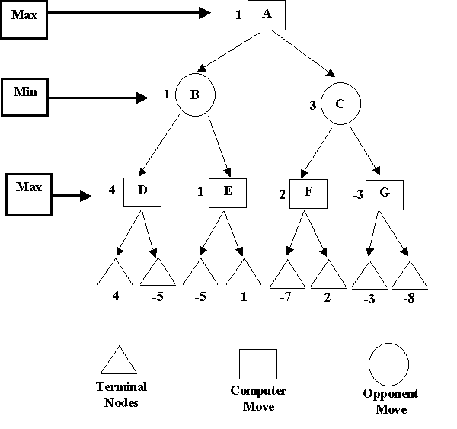
Game Tree
Nodes are states
Edges are decisions
Levels are called “plys”

Slide 7
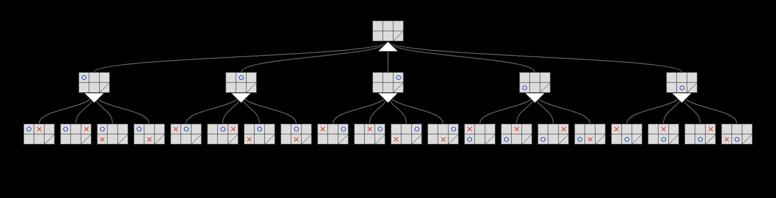

Slide 8
Notation
S₀ - Initial State
Player(s)- Who’s the player in state ‘s’
Actions(s) – Possible moves from state ‘s’
Result(s, a)- State after action ‘a’ is taken on state ‘s’
Terminal(s)-returns true if ‘s’ is a terminal state
Utility(s, p)- Objective function in state ‘s’ for player ‘p’

Slide 9
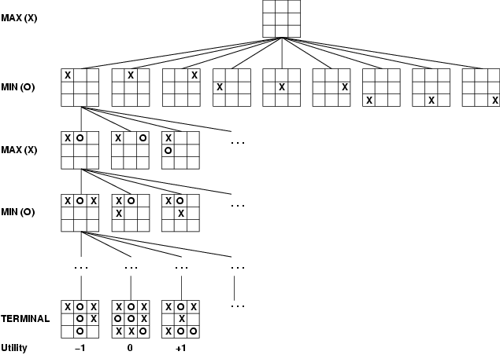
Game tree (2-player, deterministic, turns)

Slide 10
MINIMAX
Actions(s) and Result(s,a) defines a game tree
Two players Max and Min
Choose move which results in best state
Select highest expected score for you
Assume opponent is playing optimally too
Will choose lowest expected score for you
Minimax uses depth-first search
d is the maximum depth b is the branching-factor
Time complexity- ?
Space complexity- ?

Slide 11
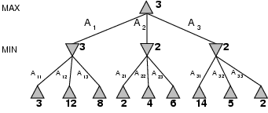
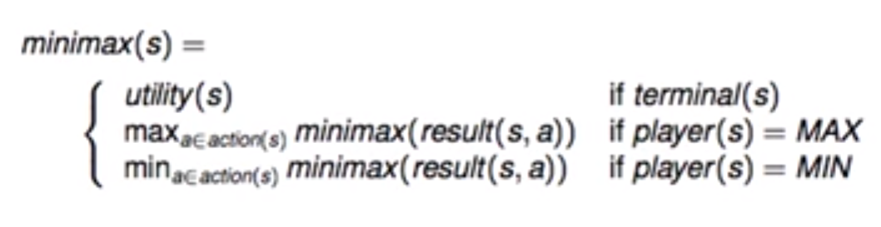
Minimax
Choose a move to position with highest minimax value
Pick the best next move against your best move
E.g., 2-ply game:

Slide 12
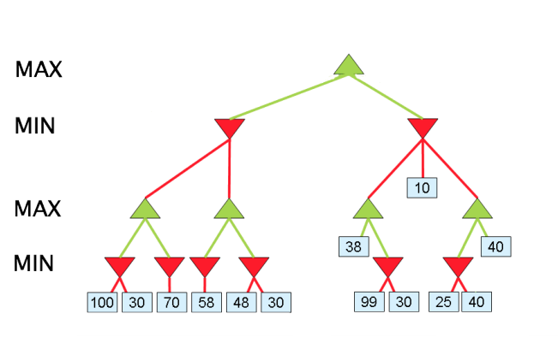
Solve…

Slide 13
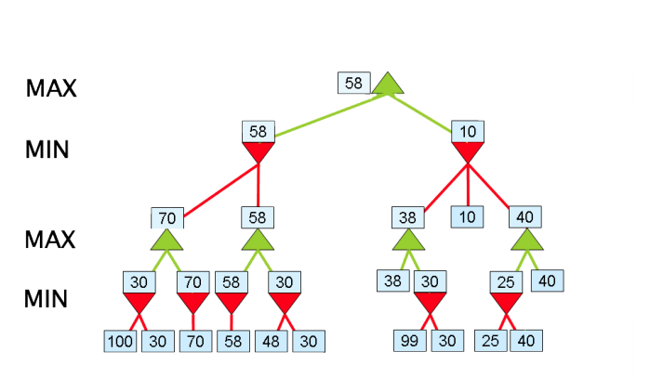

Slide 14
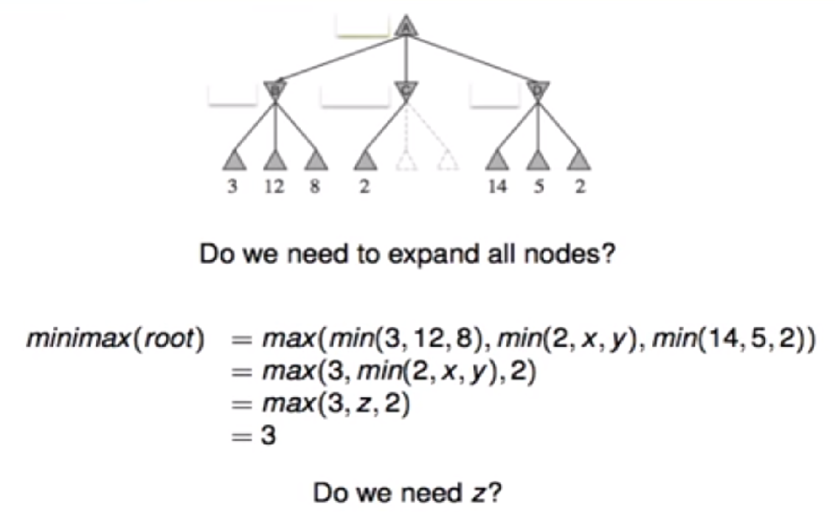
Alpha Beta Pruning

Slide 15
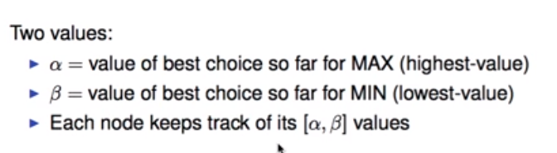
Alpha Beta Pruning

Slide 16
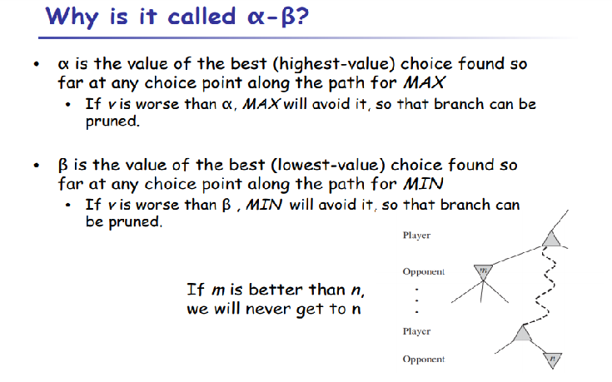

Slide 17
Alpha-beta Pruning Algorithm
Alphabeta(node, depth, alpha, beta, maximizer):
If depth = 0 or node is a terminal:
Return node value
If maximizer:
Value = -inf
For each child of node:
Value = Max(Value, Alphabeta(child, depth-1, alpha, beta, FALSE))
If Value >= beta:
Prune beta
Return Value
Else:
Value = +inf
For each child of node:
Value = Min(Value, Alphabeta(child, depth-1, alpha, beta, TRUE))
If Value <= alpha:
Prune alpha
Return Value
Alphabeta(origin, depth, -inf, +inf, TRUE)

Slide 18
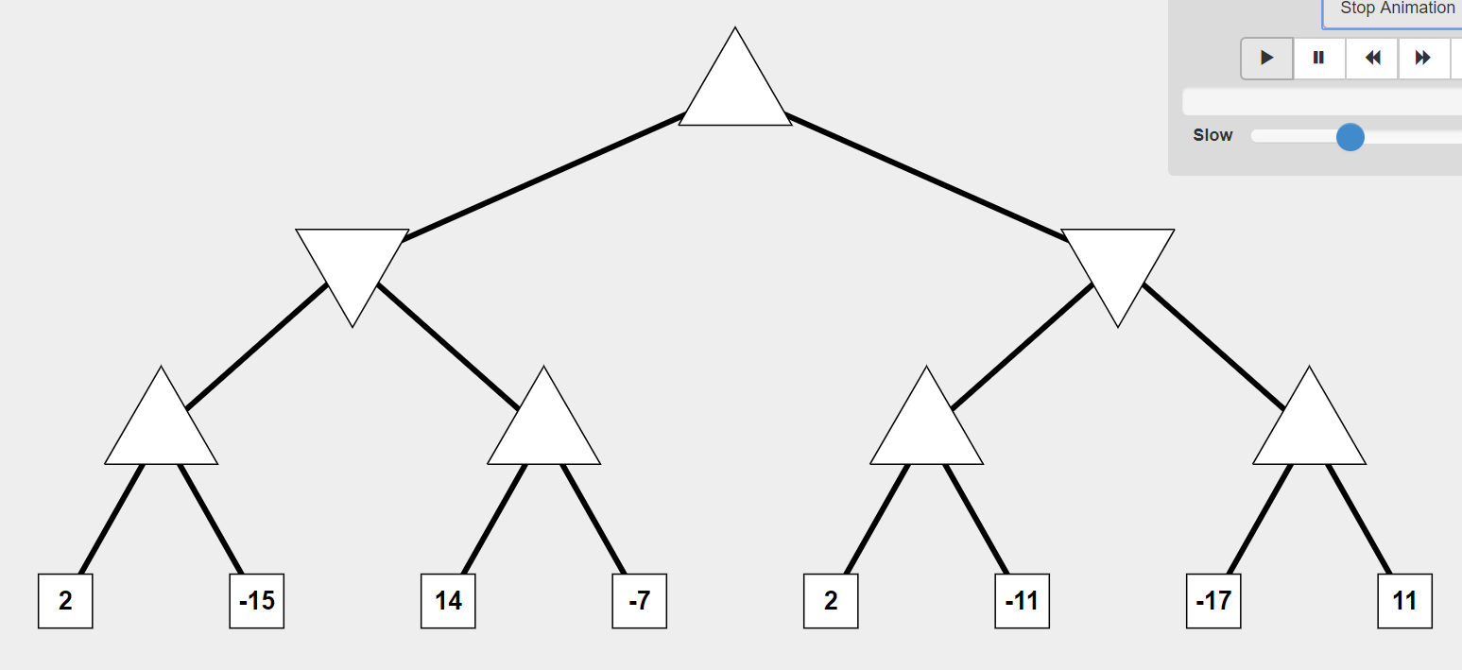
http://inst.eecs.berkeley.edu/~cs61b/fa14/ta-materials/apps/ab_tree_practice/

Slide 19
Solution (Initial)
a = -Min
b=Max
V=?
If a >= b, prune!
a = -Min
b=Max
V=?
a = -Min
b=Max
V=?
a = -Min
b = Max
V=?
a = -Min
b = Max
V=?
a = -Min
B = Max
V=?
a = -Min
b=Max
V=?
2
-15
14
-7
2
-11
-17
11

Slide 20
Solution
a = -Min
b=Max
V=?
a = -Min
b = Max
V=?
a = -Min
b = Max
V=?
a = 2
b = Max
V=2
a = -Min
b = Max
V=?
a = -Min
b = Max
V=?
a = -Min
b=Max
V=?
2
-15
14
-7
2
-11
-17
11

Slide 21
Solution
a = -Min
b=Max
V=?
a = -Min
b = 2
V = 2
a = -Min
b = Max
V=?
a = 2
b = Max
V=2
a = -Min
b = Max
V=?
a = -Min
b = Max
V=?
a = -Min
b=Max
V=?
2
-15
14
-7
2
-11
-17
11

Slide 22
Solution
a = -Min
b=Max
V=?
If a >= b, prune!
a = -Min
b = 2
V = 2
a = -Min
b = Max
V=?
a = 2
b = Max
V=2
a = 14
b = 2
V=14
a = -Min
b = Max
V=?
a = -Min
b=Max
V=?
2
-15
14
-7
2
-11
-17
11

Slide 23
Solution
a = 2
b=Max
V = 2
a = -Min
b = 2
V = 2
a = -Min
b = Max
V=?
a = 2
b = Max
V=2
a = 14
b = 2
V=14
a = -Min
b = Max
V=?
a = -Min
b=Max
V=?
2
-15
14
-7
2
-11
-17
11

Slide 24
Solution
a = 2
b = Max
V = 2
a = -Min
b = 2
V = 2
a = 2
b = Max
V=?
a = 2
b = Max
V=2
a = 14
b = 2
V=14
a = 2
b = Max
V= 2
a = -Min
b=Max
V=?
2
-15
14
-7
2
-11
-17
11

Slide 25
Solution
a = 2
b = Max
V = 2
If a >= b, prune!
a = -Min
b = 2
V = 2
a = 2
b = 2
V= 2
a = 2
b = Max
V=2
a = 14
b = 2
V=14
a = 2
b = Max
V=?
a = -Min
b=Max
V=?
2
-15
14
-7
2
-11
-17
11

Slide 26
Final Solution
a = 2
b = Max
V = 2
If a >= b, prune!
a = -Min
b = 2
V = 2
a = 2
b = 2
V=2
a = 2
b = Max
V=2
a = 14
b = 2
V=14
a = 2
b = Max
V=?
a = -Min
b=Max
V=?
2
-15
14
-7
2
-11
-17
11

Slide 27
